Slide 1

Cloud Computing
Haider Abedi – Junior DevOps Consultant

Slide 2
Agenda
What Is Cloud Computing & The Benefits
AWS Global Structure - Cloud Service Provider
Cloud Service Models – SAAS, PAAS, IAAS
Summary

Slide 3
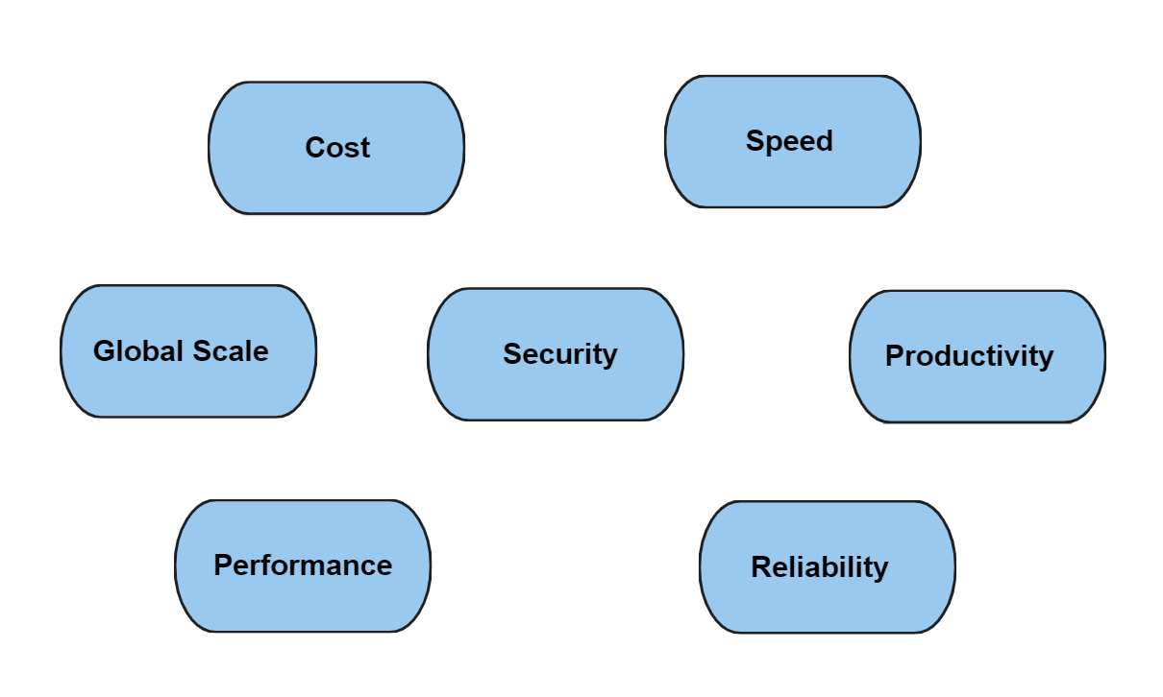
Cloud Computing & The Benefits
Simply a concept that sees the delivery of computing services—including servers, storage, databases, networking, software, analytics, and intelligence—over the Internet (“the cloud”).
This is to offer faster innovation, flexible resources, and economies of scale.

Slide 4
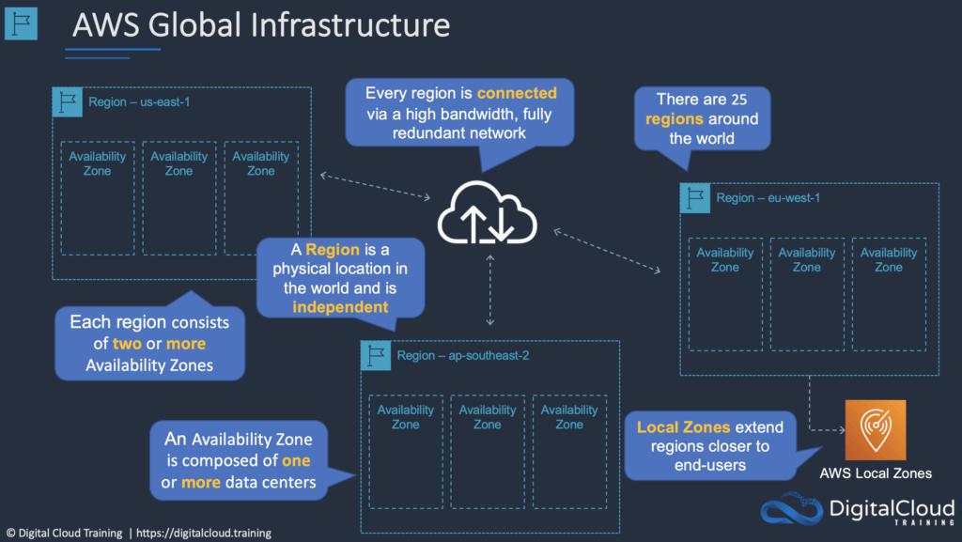
Amazon Web Services (AWS)

Slide 5
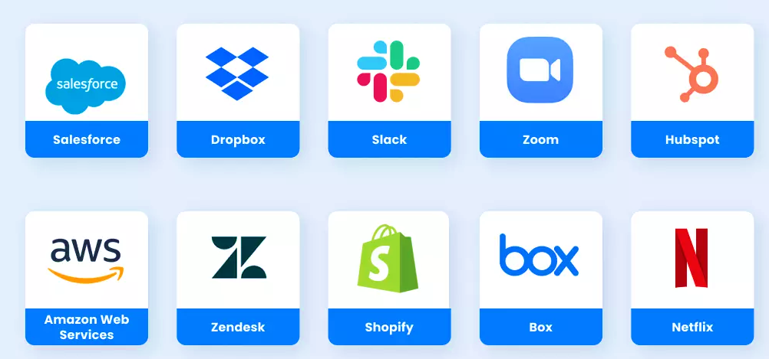
Software As A Service (SAAS)
Cloud provider completely develops and maintains cloud application software, provides automatic software updates, and makes software available to its customers via the internet (browser) on a pay-as-you-go basis.
Pros:
Access data anywhere
Pay only for what you use.
Use free client software.
Cons:
Loss of control
Insufficient Data Security
Restricted Data Mobility

Slide 6
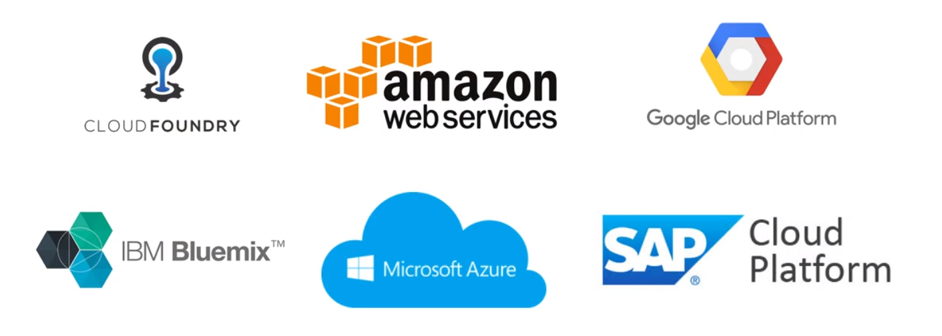
Platform As A Service (PAAS)
Complete development and deployment environment in the cloud.
Purchases resources you utilise on a pay-as-you-go basis and access them over a secure Internet connection.
Pros:
Cut coding time
Support geographically distributed development
Develop for multiple platforms – including mobile – more easily
Cons:
Security Risks
Compatibility Issues

Slide 7
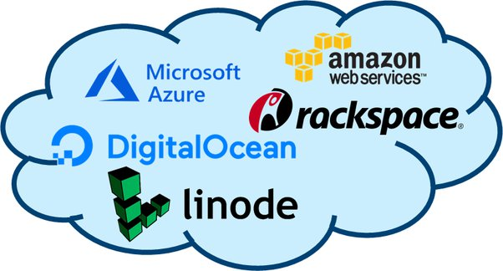
Infrastructure As A Service (IAAS)
Cloud model that offers essential compute, storage, and networking resources on demand, on a pay-as-you-go basis.
Pros:
Reduces capital expenditures and optimises costs
Enhances security
Increases scale and performance of IT workload
Cons:
Upgrade and maintenance
Over dependency
Security Risks

Slide 8
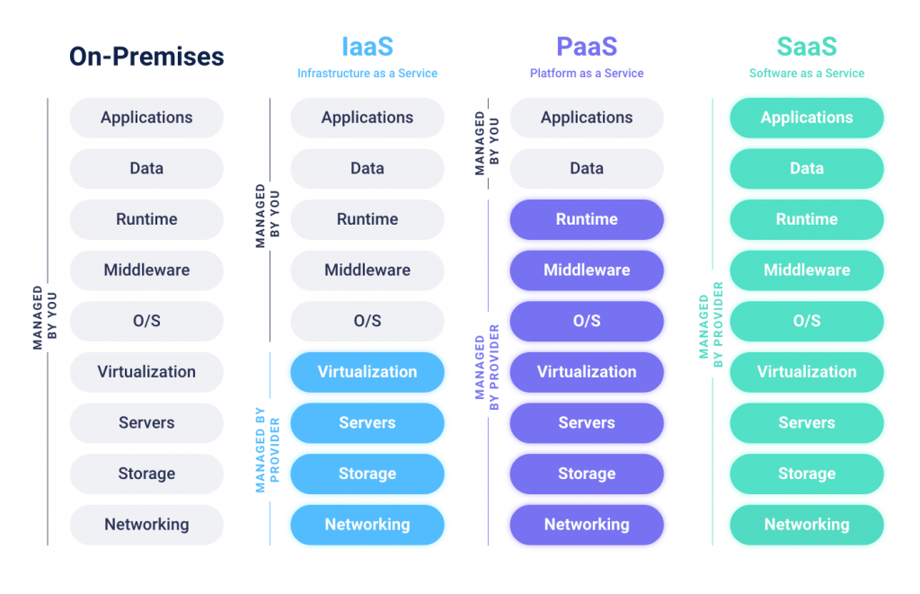
Summary
Worldwide organisations are adopting cloud (serverless) computing due to its great benefits hence it’s the future of the technological industry.
Providers like AWS are key players in shaping cloud computing and helping with data migrations in organisations.
Cloud service providers provide a selection of models for organisations to have the flexibility to choose from as per their requirements.

